Slide 1
Speech Enhancement based Approximate Message Passing
Presented by: Guide by:
K.Yeshwanth(21031DB011) Dr.K.Santhisree
M.Tech(DS) Professor of IT & Head
DIT, JNTUH. DIT, JNTUH.

Slide 2
Content of a Project
Abstract
Existing model
Proposed work
Architecture
Workflow
Dataset
Performance metrics
Experimental Results
Conclusion

Slide 3
Abstract
A novel speech improvement technique based on the approximate message passing (AMP) is adopted to get beyond the drawbacks of traditional speech enhancement methods, such as inaccurate voice activity detector (VAD) and noise estimation.
To eliminate or muffle the noise from the distorted speech, AMP takes advantage of the difference between speech and noise sparsity.
The AMP method is used to effectively rebuild clean speech for speech augmentation. More specifically, the prior probability distribution of the speech sparsity coefficient is represented by a Gaussian model.
The expectation maximization (EM) technique provides excellent learning of the hyper-parameters of the prior model.

Slide 4
We use the k-nearest neighbor (k-NN) approach to learn the sparsity while taking into account the correlation between the speech coefficients in neighboring frames.
Additionally, computational simulations are used to verify the proposed algorithm, which outperforms
the three methods which are kalman filter, principal component analysis(PCA),
independent component analysis(ICA) under a variety of signal to noise ratios and compression ratios (SNRs).

Slide 5
Existing model
A sparse signal can be effectively recovered using compressive sampling (CS) using many fewer samples than those called for by the Nyquist-Shannon sampling theorem.
Although it is not sparse enough on any available canonical basis, extracting a voice signal from its CS samples is a difficult challenge.
A turbo framework is used to reconstruct the speech signal from CS samples. This framework alternately iterates AMP and belief propagation through the Markov chain.
Additionally, a constraint is added to the turbo iteration to stop the new approach from diverging. Numerous tests demonstrate that the novel method produces a greater signal-to-noise ratio.
A higher perceptual evaluation of speech quality (PESQ) score when compared to other standard CS methods.

Slide 6
Proposed work
We used a novel speech enhancement method based on AMP-NNSPL in this study, which takes use of the sparse properties of speech signals in the DCT domain but not for noise.
Our adopted approach outperformed the other three algorithms in terms of NMSE, PESQ, and recovery performance, according to a set of experimental results.
It is important to note that the suggested approach does not depend on noise estimates or the VAD process and totally satisfies sparse.

Slide 7
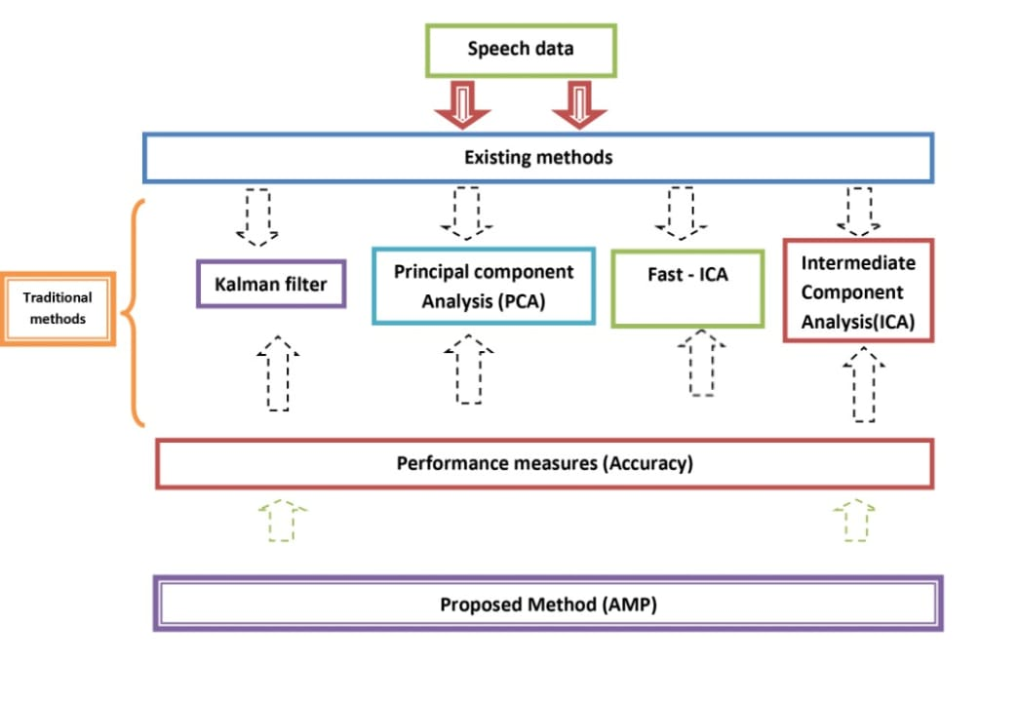
Architecture
Fig.no.1: Architecture of the proposed system

Slide 8
Workflow
Speech dataset was preprocessed for the project.
Algorithmic changes were made in the project, as the collaboration between dsamp and em-gamp was resulting in errors, despite the presence of wiener filter and subspace pursuit.
The project now utilizes Kalman filter, PCA, and ICA algorithms for better performance and noise removal, based on references from other papers.
Kalman filter was implemented as the proposed method.
Performance metrics such as MSE and RMSE were identified and used.
Currently, Principal Component Analysis (PCA) and Intermediate Component Analysis (ICA) are being implemented for further analysis.
Comparison was made between existing and proposed models.

Slide 9
Dataset
In this project speech sound dataset is being used which is from the Git-hub.
In this dataset the attributes are audios, file path , start segment, end segment, hertz, decibels and sample frequency.
S.no | Audio | File path | Start segment | End segment | hertz | decibles | Sample Frequency
1 | source1.wav | Click here!! | 0 | 0.5 | 1895.36 Hz | 0.35 dB | 8000 Hz
2 | source2.wav | Click here!! | 0.1 | 0.3 | 134.56 Hz | 0.49 dB | 8000 Hz
3 | source3.wav | Click here!! | 0.1 | 0.6 | 34.88 Hz | 0.07 dB | 8000 Hz
4 | source4.wav | Click here!! | 0 | 0.4 | 166.88 Hz | 2.41 dB | 8000 Hz
5 | source5.wav | Click here!! | 0 | 0.4 | 97.44 Hz | 0.63 dB | 8000 Hz
Table. No. 1: speech sound dataset

Slide 10
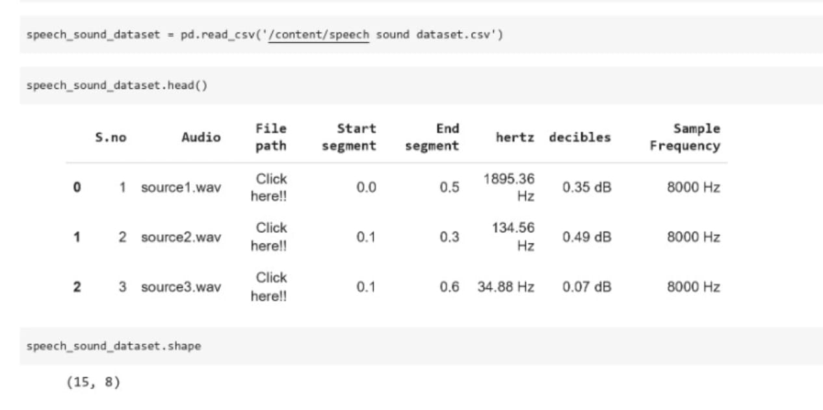
Data Preprocessing
Table.no.2(a) accessing the dataset through the panda's lib and checking the starting rows of the dataset by the head keyword and checking the shape of the dataset

Slide 11
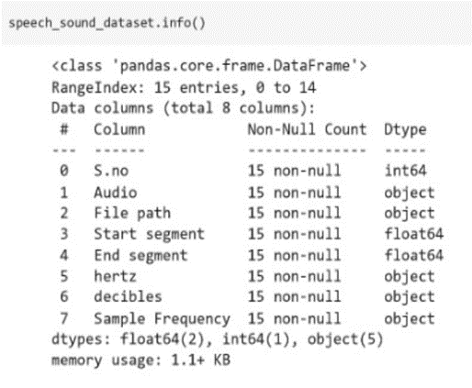
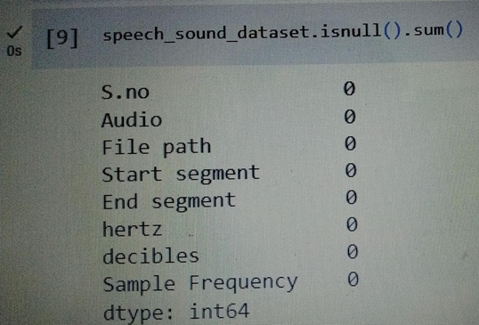
. Table.no.2(b) Checking the information of the dataset to determine whether it contains the null values
Table.no.2(c) as there are no null values from the above. If the null values exist, the is null keyword helps us to make it null

Slide 12
Performance Measures
Kalman filter :
Mean Squared Error: (1/d*n) * Σᵢ Σⱼ (Ztrue(i, j) - Zkalman(i, j))^2
Root mean squared error: √(MSE_kalman)
Mean absolute error: (1/d*n) * Σᵢ Σⱼ |Ztrue(i, j) - Zkalman(i, j)|
Peak signal to noise ratio: 20 * log₁₀(max(Ztrue(:)) / RMSE_kalman)
Principal Component Analysis:
Mean Squared Error: (1/d*n) * Σᵢ Σⱼ (Ztrue(i, j) - Zpca(i, j))^2
Root mean squared error: √(MSE_pca)
Mean absolute error: (1/d*n) * Σᵢ Σⱼ |Ztrue(i, j) - Zpca(i, j)|
Peak signal to noise ratio: 20 * log₁₀(max(Ztrue(:)) / RMSE_pca)

Slide 13
Independent Component Analysis:
Mean Squared Error: (1/d*n) * Σᵢ Σⱼ (Ztrue(i, j) - Zica(i, j))^2
Root mean squared error: √(MSE_ica)
Mean absolute error: (1/d*n) * Σᵢ Σⱼ |Ztrue(i, j) - Zica(i, j)
Peak signal to noise ratio:20 * log₁₀(max(Ztrue(:)) / RMSE_ica)
Fast-Independent Component Analysis:
Mean Squared Error: (1/d*n) * Σᵢ Σⱼ (Ztrue(i, j) - Zfica(i, j))^2
Root mean squared error: √(MSE_fica)
Mean absolute error: (1/d*n) * Σᵢ Σⱼ |Ztrue(i, j) - Zfica(i, j)
Peak signal to noise ratio: 20 * log₁₀(max(Ztrue(:)) / RMSE_fica)

Slide 14
Experimental Results
Kalman filter:
M.S.E – 0.61
M.A.E – 0.71
R.M.S.E – 0.78
P.S.N.R – 2.14 dB
Fast-ica:
M.S.E – 0.94
M.A.E – 0.68
R.M.S.E – 0.97
P.S.N.R – 0.24 dB
Independent component analysis:
M.S.E – 1.50
M.A.E – 1.02
R.M.S.E – 1.22
P.S.N.R – 1.76 dB
Principal component analysis:
M.S.E – 0.90
M.A.E – 0.79
R.M.S.E – 0.95
P.S.N.R – 0.41 dB

Slide 15
Algorithms | BCS | COSAMP | IHT
Accuracy | 0.97 | 0.97 | 1.27
Precision | 0.90 | 0.88 | 1.08
Recall | 1.00 | 1.07 | 1.45
PESQ | 26.16 dB | 15.03 dB | 7.56 dB
Table.no.3(a) evaluation metrics of the existing system
Algorithms | Kalman filter | Fast ICA | ICA | PCA
M.S.E | 0.61 | 0.94 | 1.50 | 0.90
M.A.E | 0.71 | 0.68 | 1.02 | 0.79
R.M.S.E | 0.78 | 0.97 | 1.22 | 0.95
P.S.N.R | 2.14 dB | 0.24 dB | -1.76 dB | 0.41 dB
Table.no.3(b) evaluation metrics of the proposed system

Slide 16
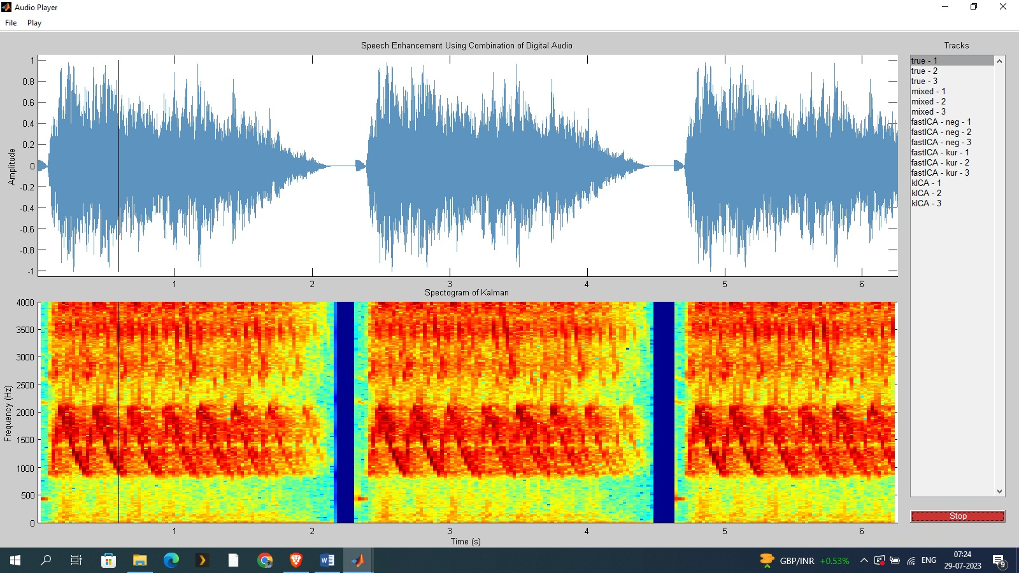
Figure 2(a): spectrogram of the speech sound by the audios

Slide 17
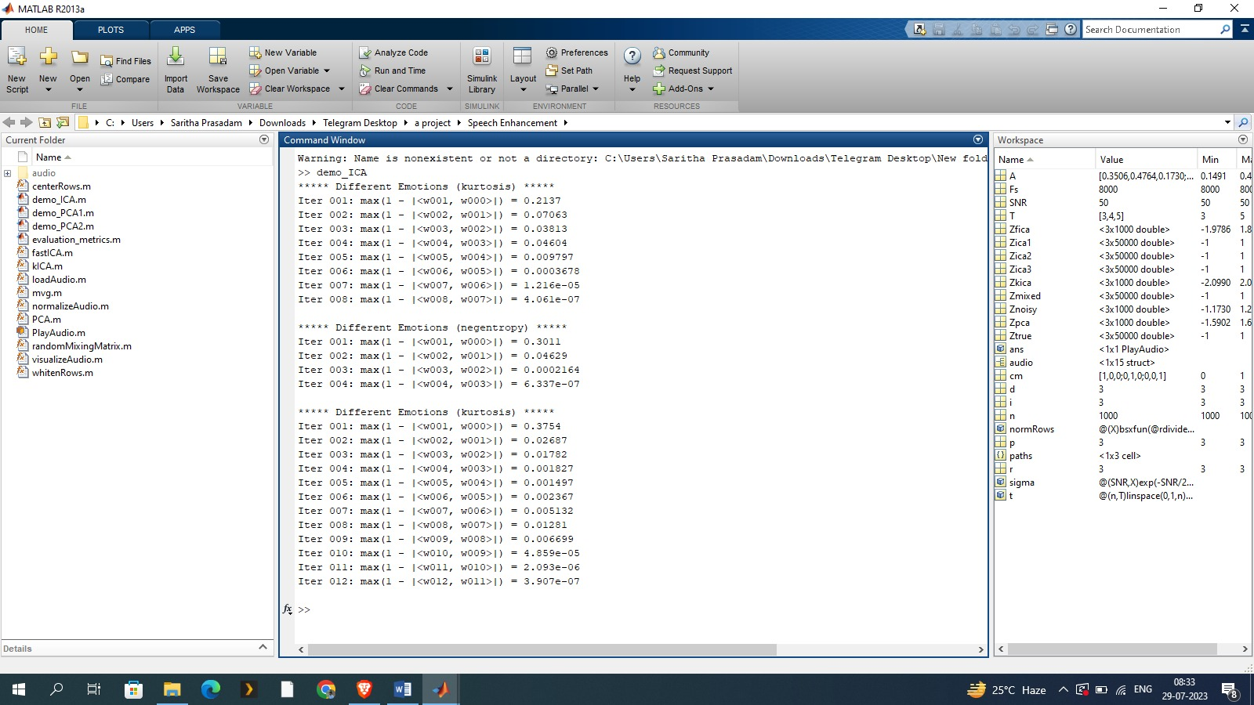
Figure.no.2(b) In above figure we can see that the noise have been eliminated after utmost iterations

Slide 18
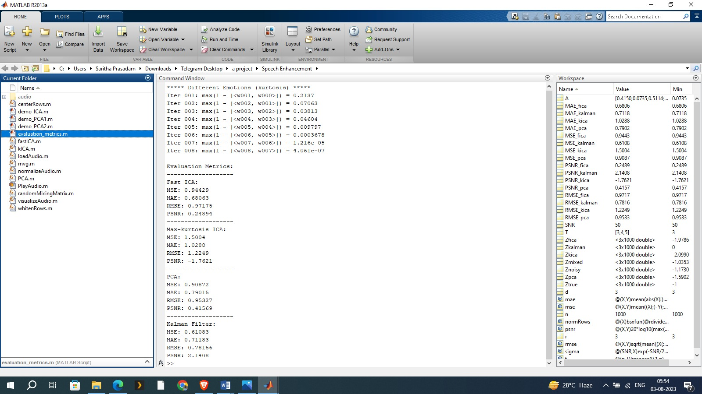
Table.no.2(c) in above figure we can see that evaluation metrics have been applied on the project. So we can show that how efficient that the project can be than the existing system

Slide 19
Conclusion
In this study, we applied an unique AMP-NNSPL-based speech augmentation technique that takes advantage of the sparse features of speech signals in the DCT domain but ignores noise. We fully leverage the correlation of neighboring coefficients in the frame to update the sparse rates in each AMP cycle, which significantly improves recovery accuracy.
According to a set of experimental findings, our selected technique performed better than the other three baseline algorithms in terms of NMSE, PESQ, and recovery performance.
A appropriate compression ratio will make voice communication easier, and it has a low degree of complexity without sacrificing clearly audible or high-quality speech.

Slide 20
THANK YOU

